Slide 1

Team Members 1) Sri Harsha Vardhan Yendru (00841138) 2) Sai Adithya Rao (00871397)
SMS Spam Detection

Slide 2

SMS Spam Detection Project
The project focuses on building a system to identify spam messages in SMS using machine learning techniques implemented in Python, with a particular emphasis on leveraging TensorFlow for deep learning.

Slide 3

Project Objectives
Develop an effective machine learning model capable of accurately categorizing SMS messages as either spam or non-spam (ham).
Explore a variety of methodologies in text classification, including both traditional machine learning algorithms and deep learning strategies utilizing TensorFlow.
Evaluate and compare the performance of various models to determine the most efficient approach for SMS spam detection.

Slide 4
Project Approaches
Machine and deep learning Algorithms
Multinomial Navie Bayes
TfidfVectorizer
TensorFlow
Keras
Libraries
Numpy
Pandas
Matplotlib
Seaborn

Slide 5
Project Methodology
Begin by importing necessary libraries, including numpy, pandas, matplotlib, seaborn, and TensorFlow.
Load and preprocess the dataset using pandas' read_csv() function, conducting exploratory data analysis to understand the distribution of spam and ham messages and the average sentence length.
Construct a baseline model using the MultinomialNB() algorithm and evaluate its performance, including generating a confusion matrix.
Develop and compile custom text vectorization and embedding layers using TensorFlow.
Implement transfer learning with Universal Sentence Encoder (USE) to enhance model performance

Slide 6
Expected Deliverables
Item 1: Preprocessed dataset ensuring balanced features representation.
Item 2: Evaluation report detailing the performance of the baseline model, including insights from the confusion matrix analysis.
Item 3: Trained deep learning models, incorporating custom text vectorization and embedding layers.
Item 4: Comprehensive evaluation metrics for each model, encompassing accuracy, precision, recall, and F1-score.
Relevance: These deliverables are pivotal in fulfilling the project objectives by offering insights into the effectiveness of different models for SMS spam detection.

Slide 7
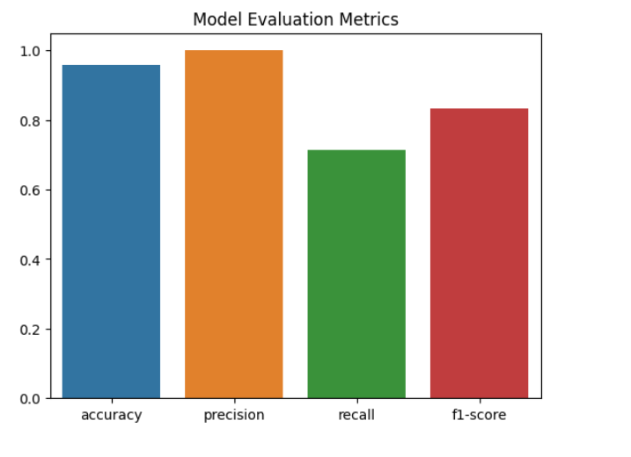
Model Evaluation Metrics

Slide 8
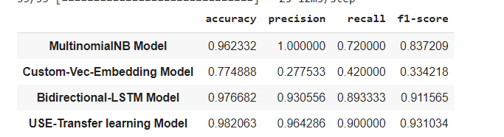
Performace of Multiple Models

Slide 9

Evaluation Strategy
Assess model performance utilizing metrics such as accuracy, precision, recall, and F1-score.
Prioritize consideration of false negatives and false positives due to the dataset's unbalanced nature.
Leverage F1-score as the primary metric for model comparison and selection, as it offers a balanced assessment of accuracy and recall.
This evaluation strategy ensures the identification of the most suitable model for SMS spam detection, factoring in both accuracy and recall metrics.

Slide 10


